Slide 1



RACIMO: Red Ambiental Ciudadana de Monitoreo
(Citizen monitoring environmental Network) and
LA-CoNGA Physics: Latin-American alliance for Capacity buildinG in Advanced physics
Luis A. Núñez
School of Physics, Universidad Industrial de Santander
Bucaramanga-Colombia o.b.o
LA-CoNGA phyisics
Tweeter @nunezluis
December 9th – 10th 2020

Slide 2
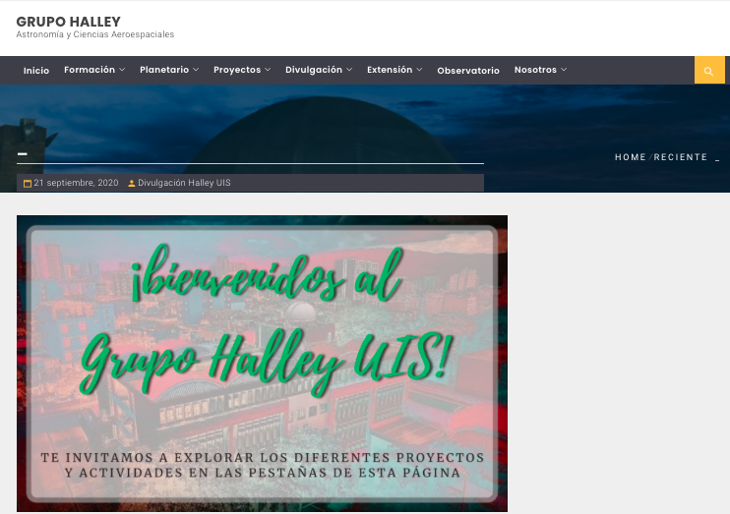
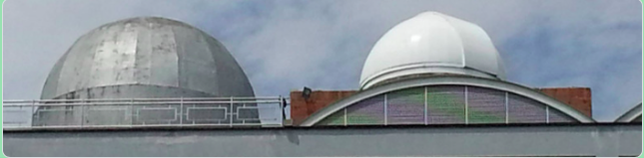
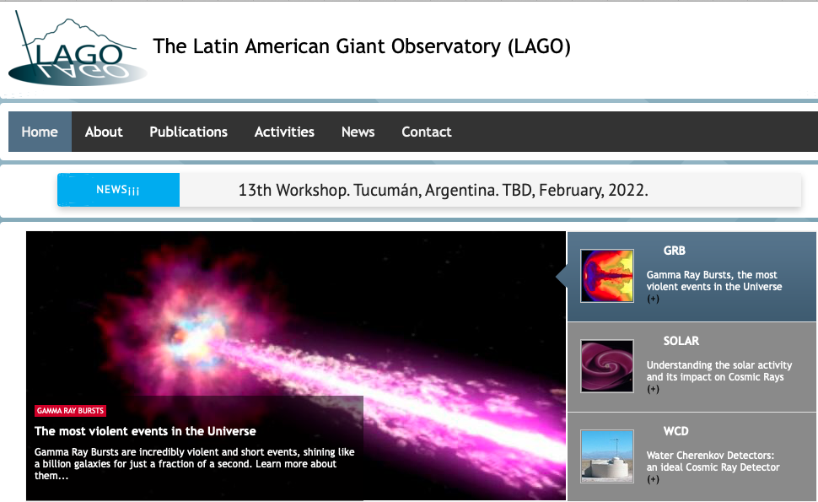
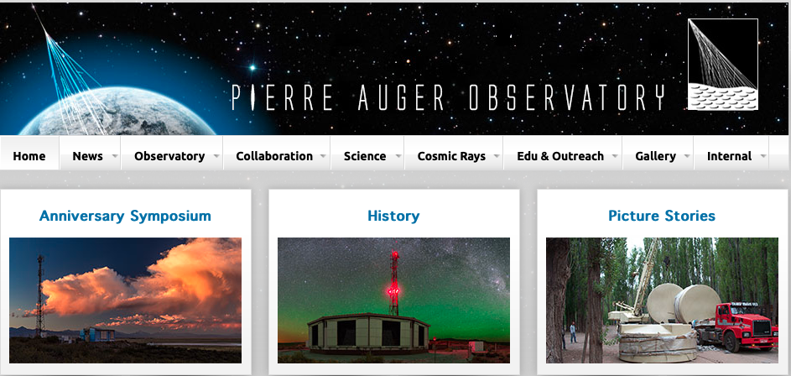
Who are we?
Combination of young amateur outreach astronomer club &
Astroparticle research group
Physics School Universidad Industrial de Santander
Bucaramanga Colombia
1

Slide 3
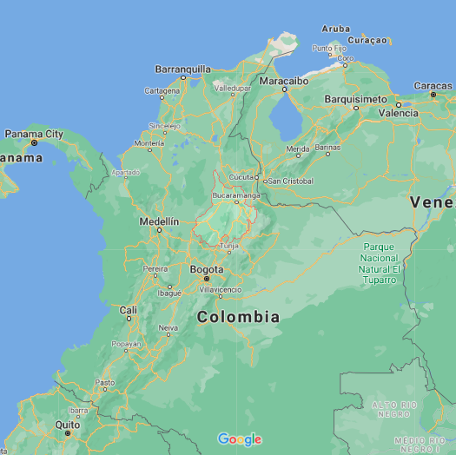
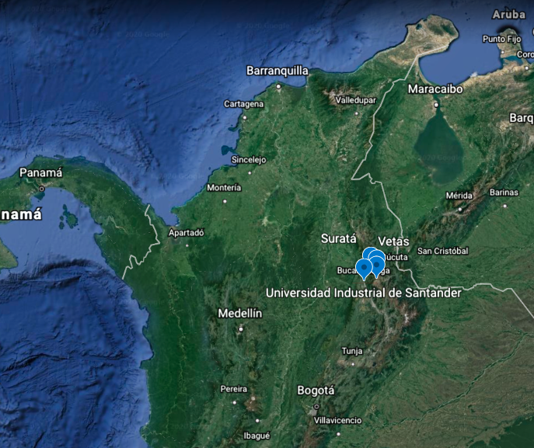
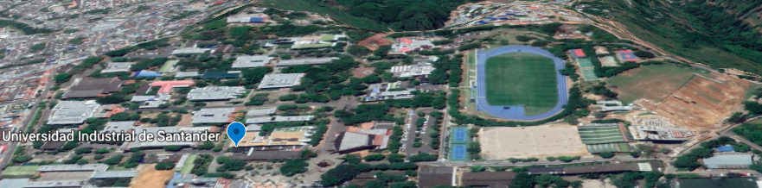
Where are we?
Public Departamental University.
~25000 pregradutates 1000 graduates
~500 Faculty
~120 Preg ~20 Master ~10 Doctoral
Universidad Industrial de Santander, Bucaramanga Colombia
2

Slide 4











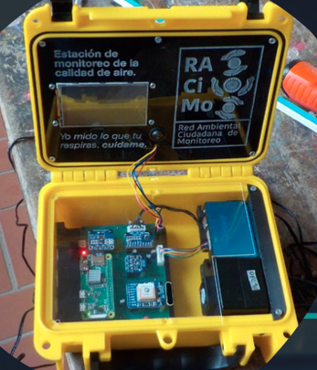

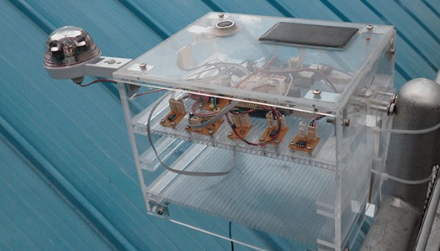
RACIMO evolution at glance ~6years City/Rural
2014 RACIMO
2018
RACIMO-Air
2019 EVA MakeSense
2020 AstroPáramo
2021 AstroAndes
Funding & strategic alliances
3 secondary rural schools
Impacting 21 students 3 teachers
8 secondary schools Metro-Bucaramanga
Impacting 83 students 12 teachers
5 secondary schools Bucaramanga
Impacting 48 students 9 teachers
Rising awareness Open Science
Empowering Citizen gathering and understanding environmental data
3

Slide 5
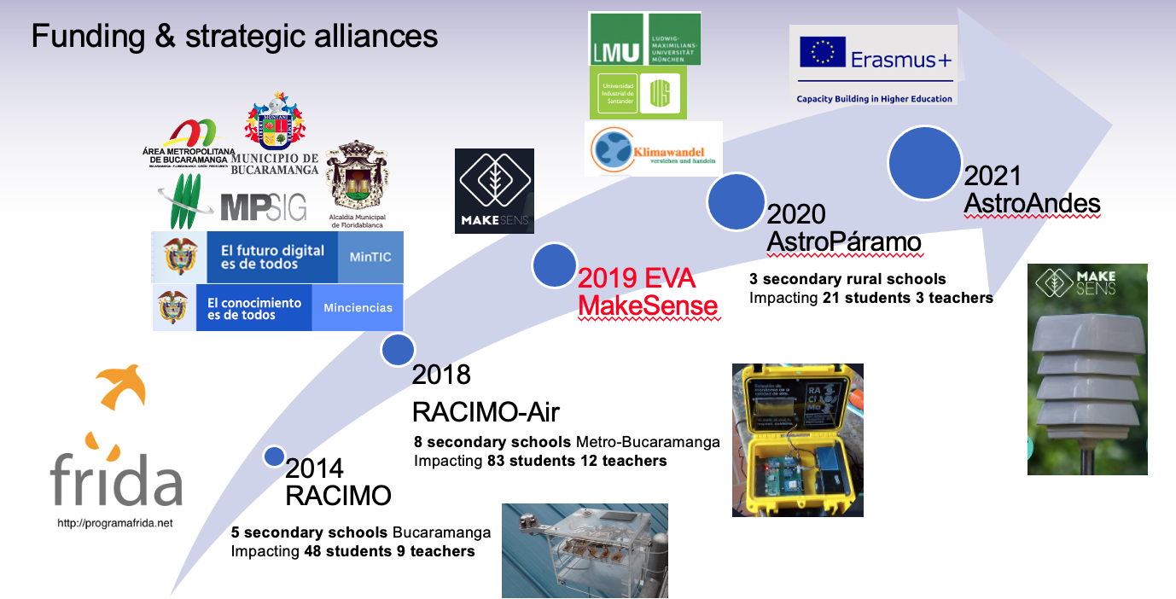
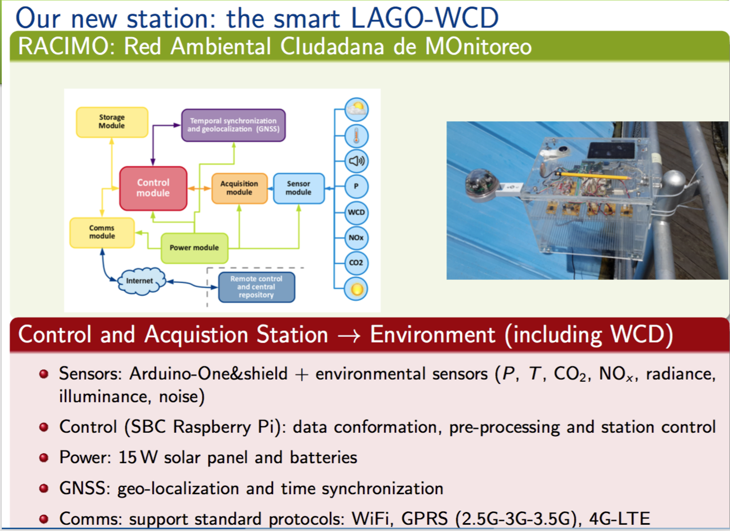
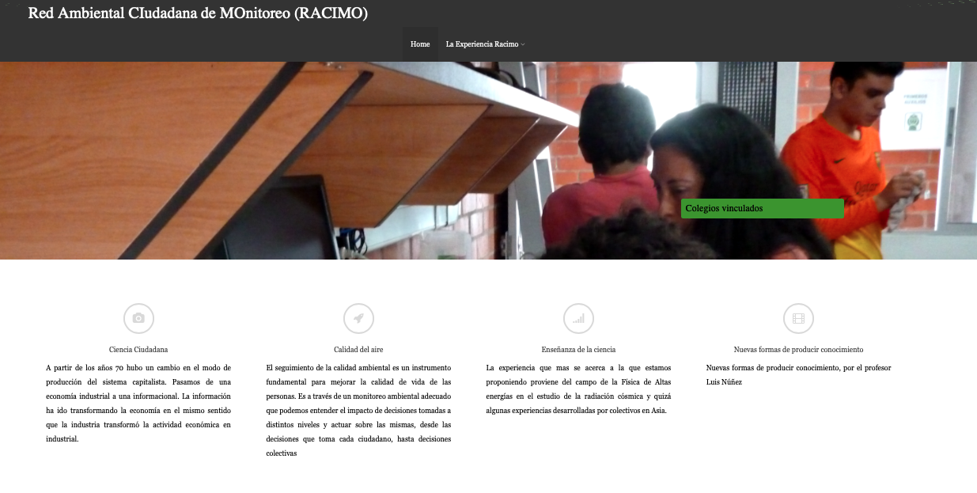
Starting RACIMO
Starting as a DYI Open Science project
Funded by FRIDA Project
5 Science Clubs in secondary schools
48 students
9 teachers
From a Cosmic Ray detector to weather station
Nine weeks activ (2h) with online support
Concepts of Citizen science & Collective intelligence
Environment Governance
Meaning of Climate Variables
Basic Statistics
Python Programming
Data Visualization
Basic Electronics
Building the station
Working with Data
4
https://halley.uis.edu.co/tierra
Generate an experience under the open science paradigm in schools

Slide 6
2014 RACIMO AIR
8 Schools
Raise awareness to school teacher/students about
the quality of the air we are breathing
Open Science paradigm
Data Science Technologies/skills
Evironmental Governance and Citizen participation
Build a complementary environmental citizen network
Profesional low-cost weather station
Software platform for weather data
A startup for sustainability
5
Eight Enviromental Science Clubs
https://halley.uis.edu.co/tierra

Slide 7
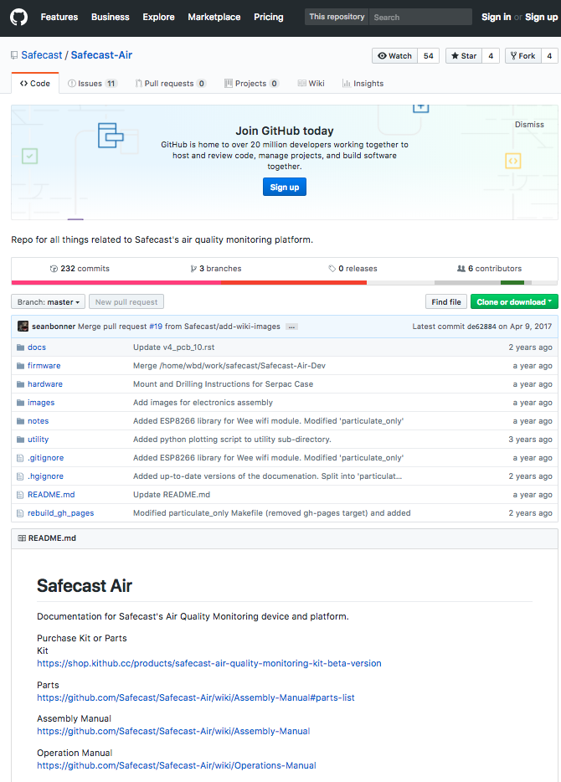
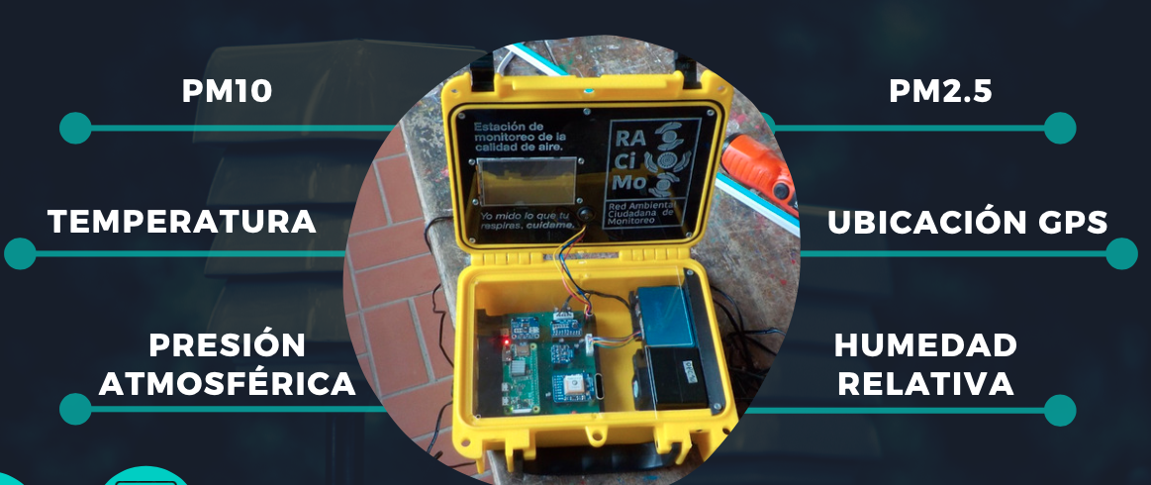
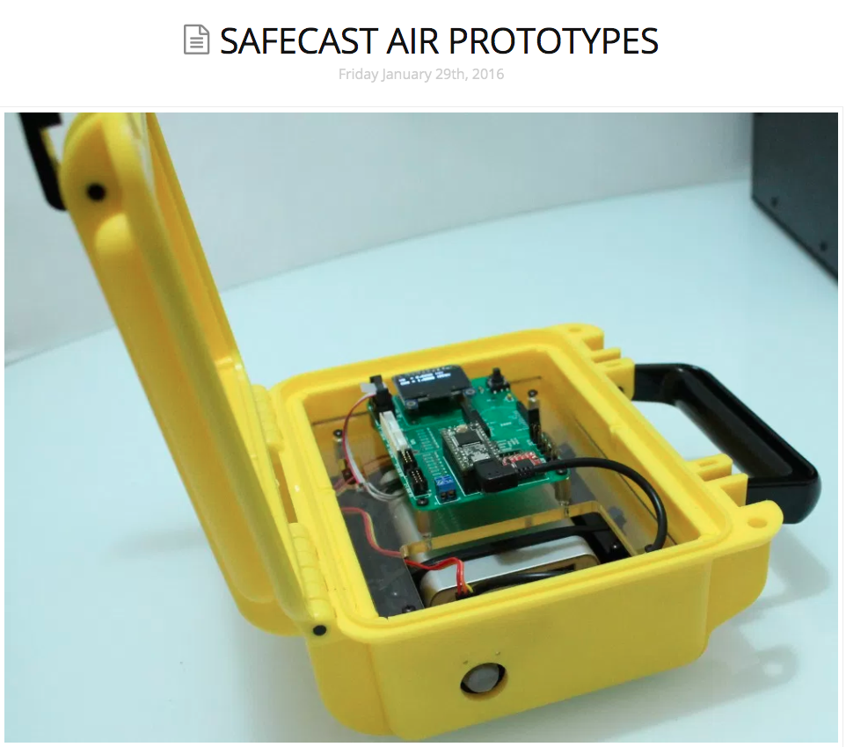

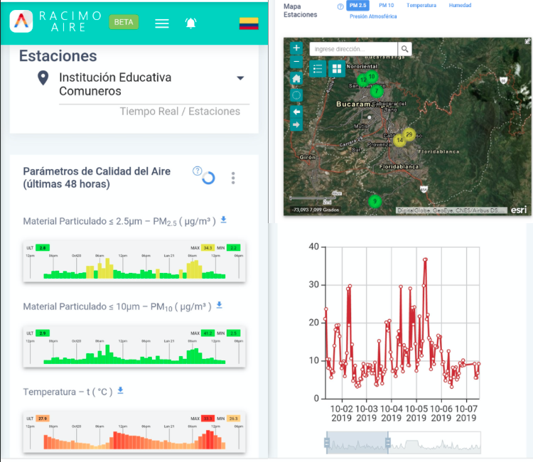
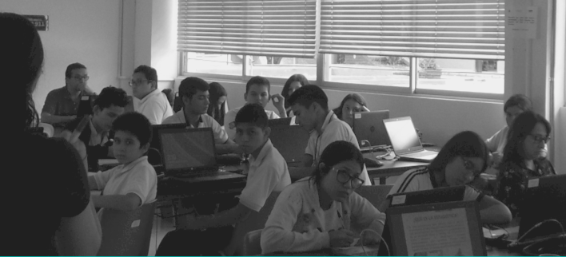
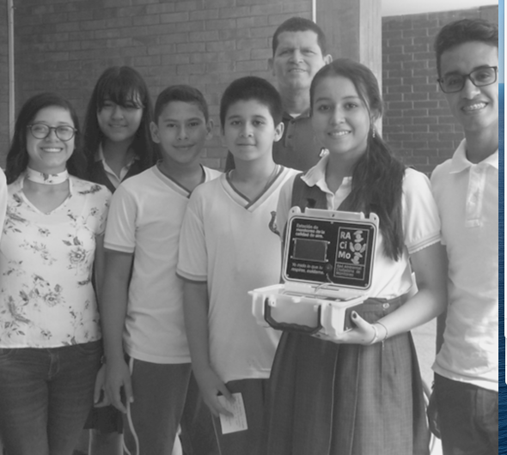
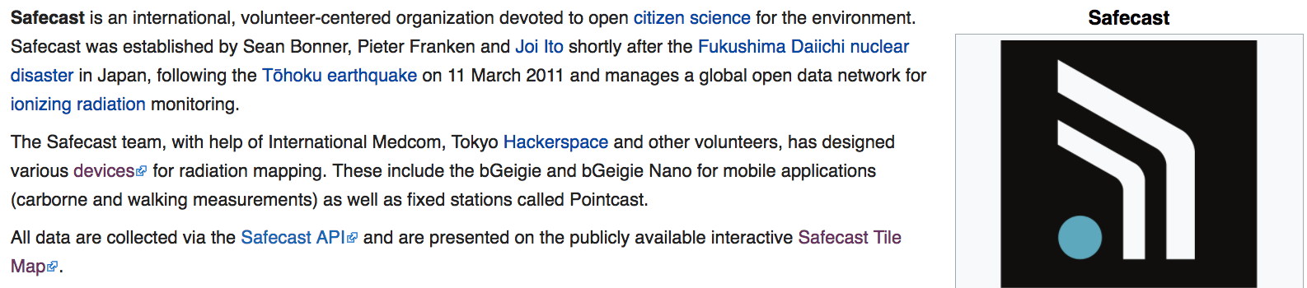
2014 RACIMO AIR
6

Slide 8
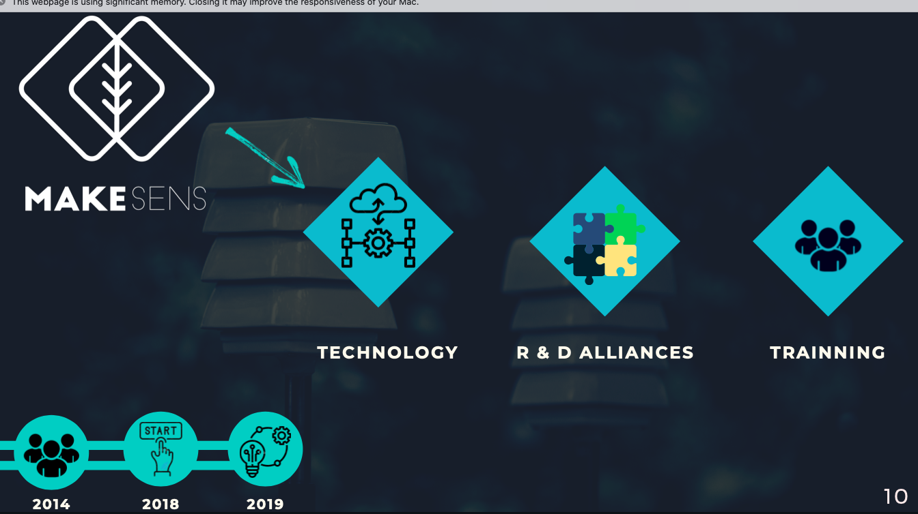
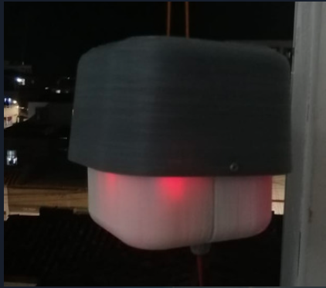
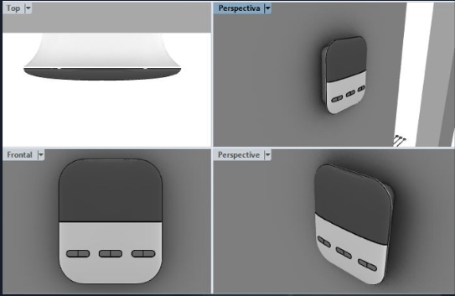

2019 MAKESENS STARTUP
Tweeter: @MakeSens_co
https://makesens19.wixsite.com/makesens

